Slide 1
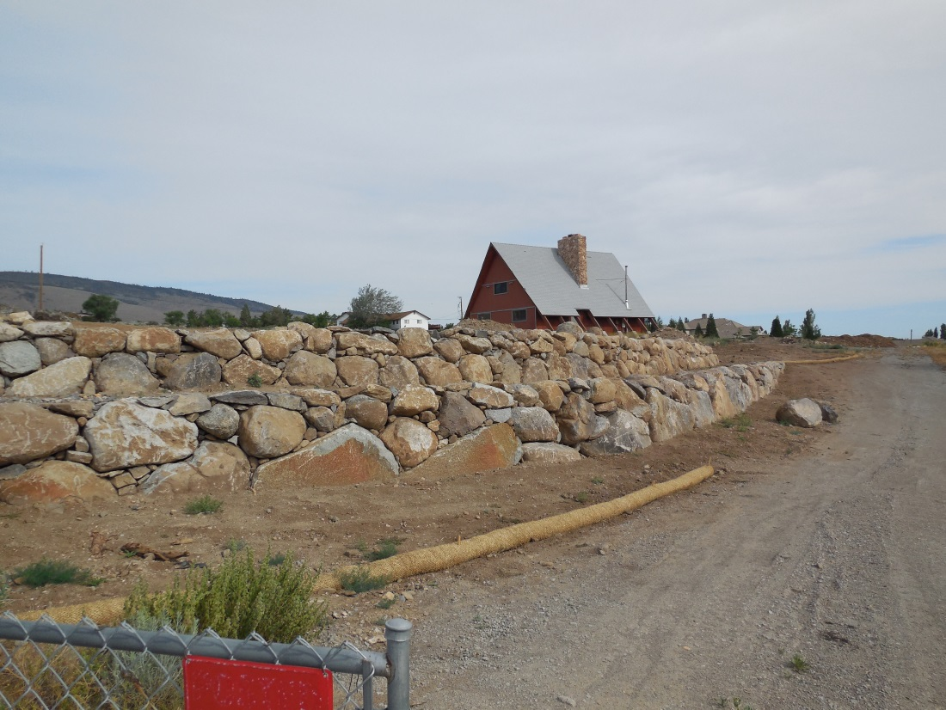
WSUP17-0023 Williams Residence Grading
Washoe County Board of Adjustment
February 1, 2018

Slide 2
Overview
Applicant: Gail Willey Landscaping
Property Owner: Amour Property Mgmt. – Lisa Williams
Location: 5435 Mt. Rose Highway

Slide 3
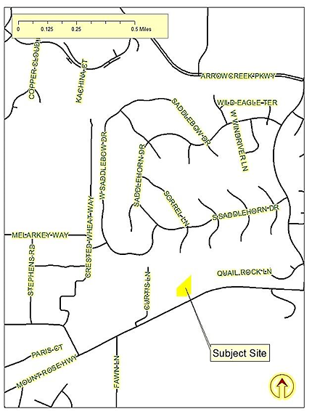
Vicinity Map

Slide 4
Request
Special use permit to permit Major Grading, including previous grading and additional grading and earthwork totaling approximately 197 cubic yards of excavation, 765 cubic yards of fill and disturbance of a total area of approximately 80,940 square feet (1.86 acres)
Grading of more than one acre on a parcel that is less than six acres in size is Major Grading in accordance with the Washoe County Development Code at 110.438.35(a)(1)(i)(A).

Slide 5
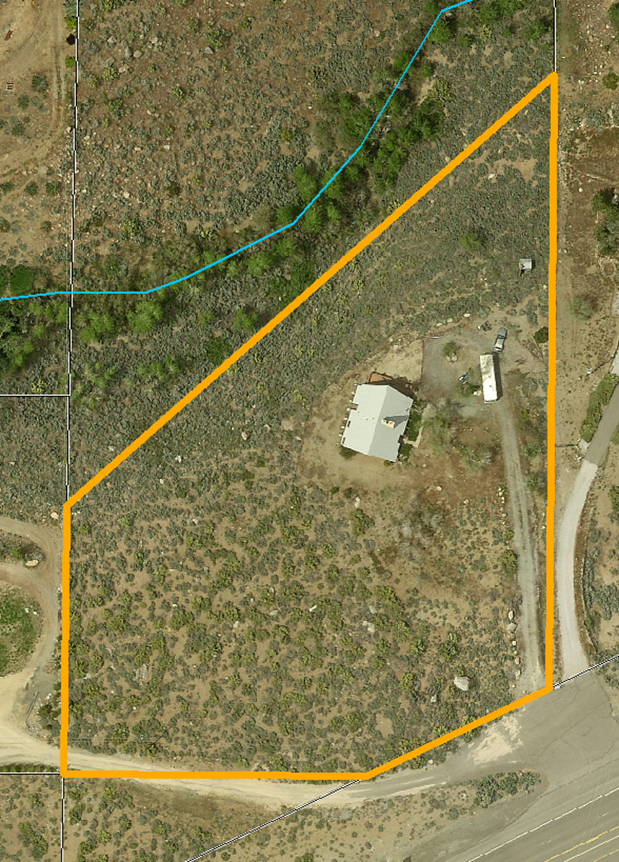
Overhead Site Photo 2011

Slide 6
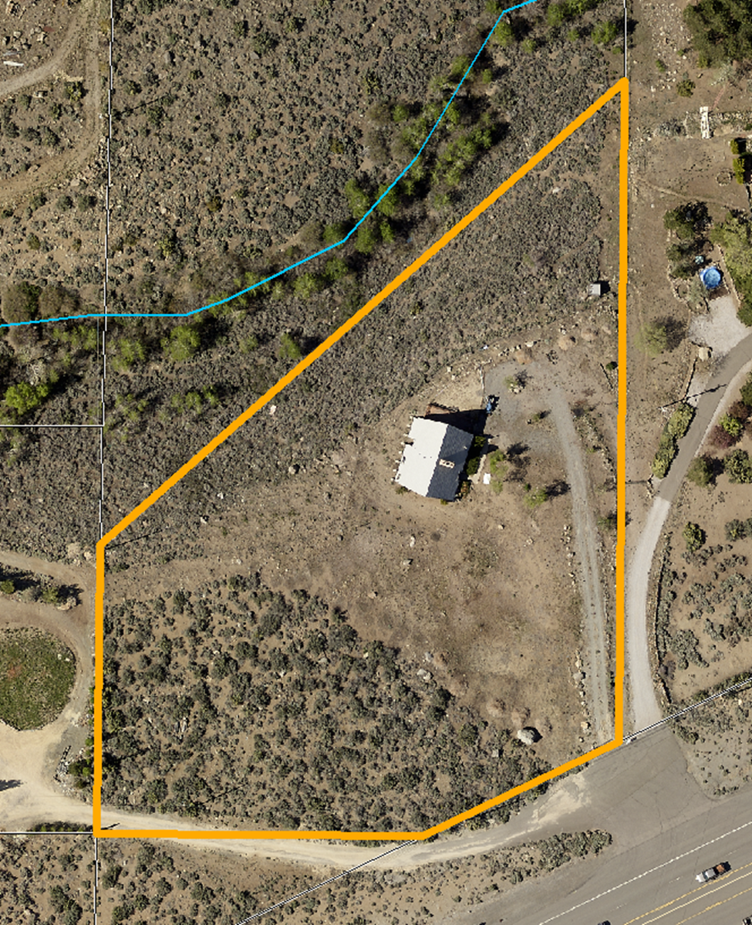
Overhead Site Photo 2013

Slide 7
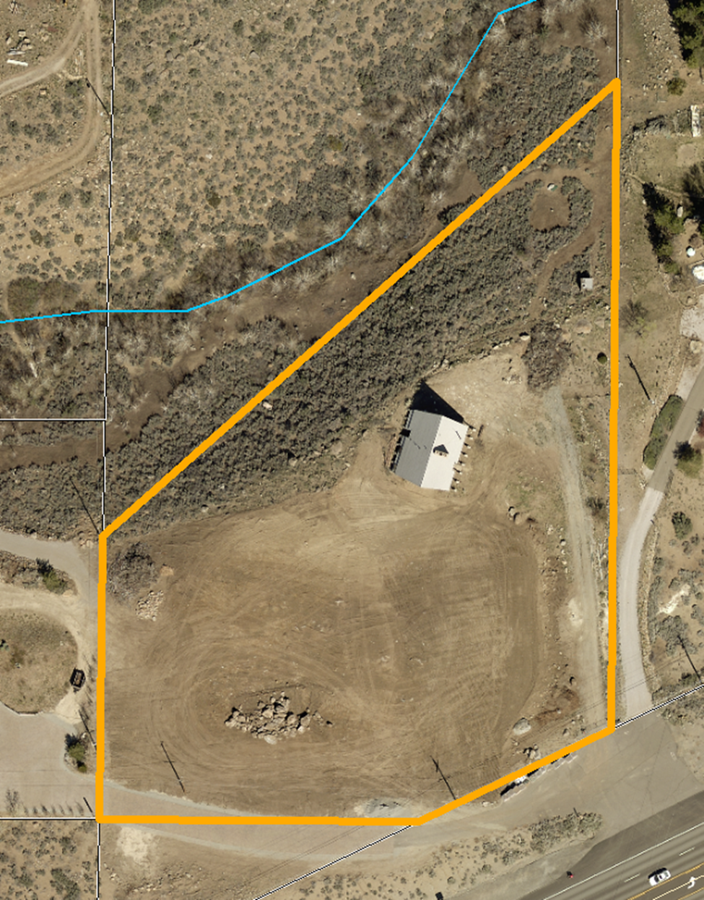
Overhead Site Photo 2015

Slide 8
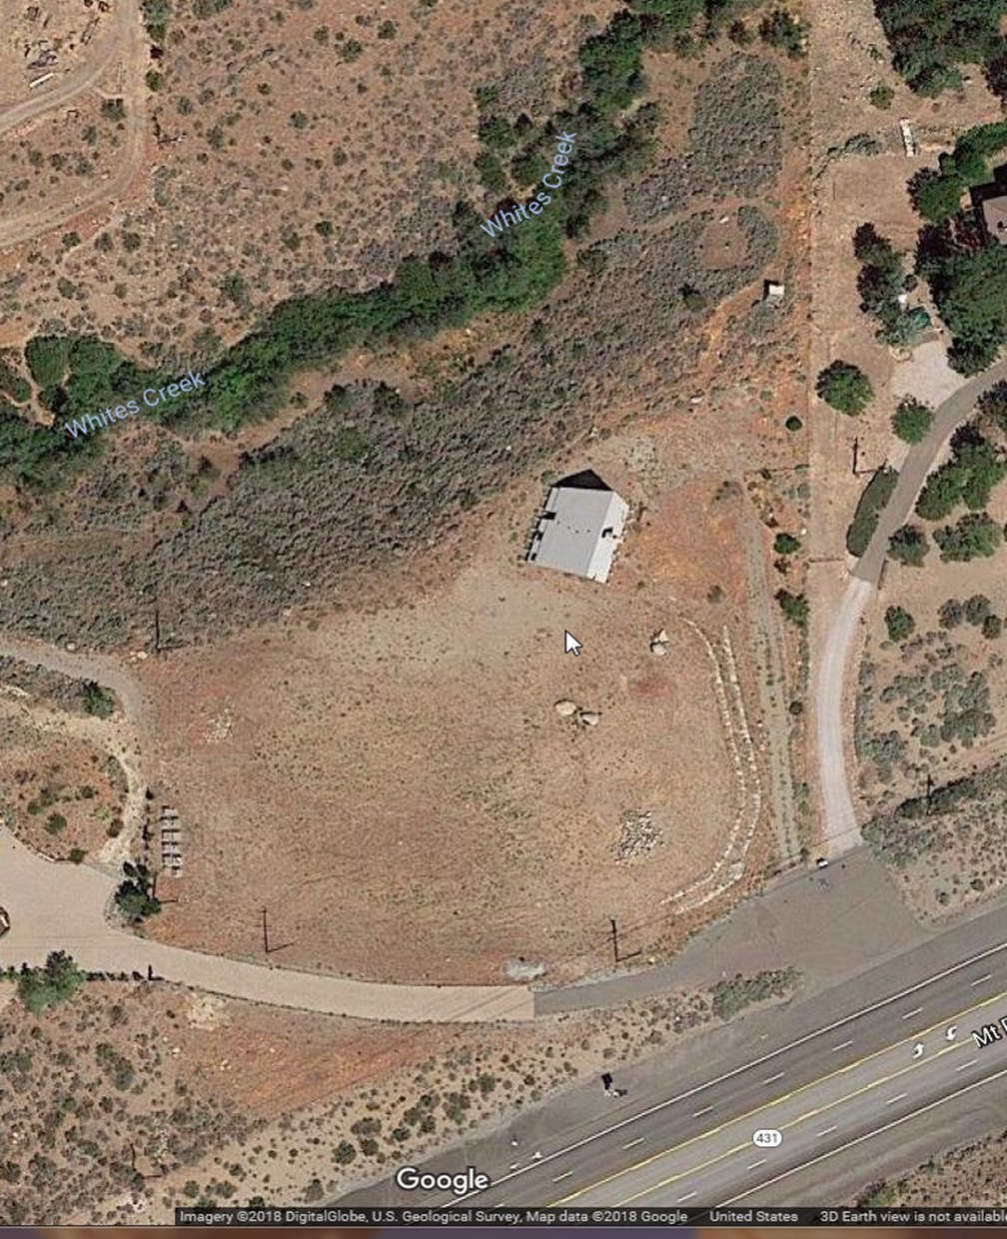
Overhead Site Photo (post 2013)

Slide 9
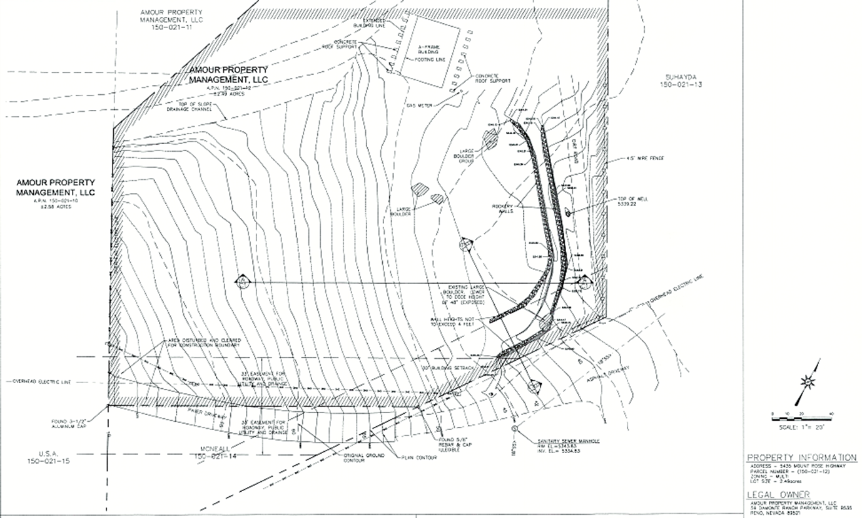
Proposed Grading Plans

Slide 10
Evaluation
SUP requested to bring previous grading into conformance with the Development Code
2014 a minor grading permit was approved
Grading done exceeded the limits of that permit
Rockery walls were constructed

Slide 11
Evaluation
Plans submitted with this application show compliance with applicable Development Code provisions
Upper wall will be relocated to inside of the building setback
Height of lower wall will be reduced to 4 feet

Slide 12
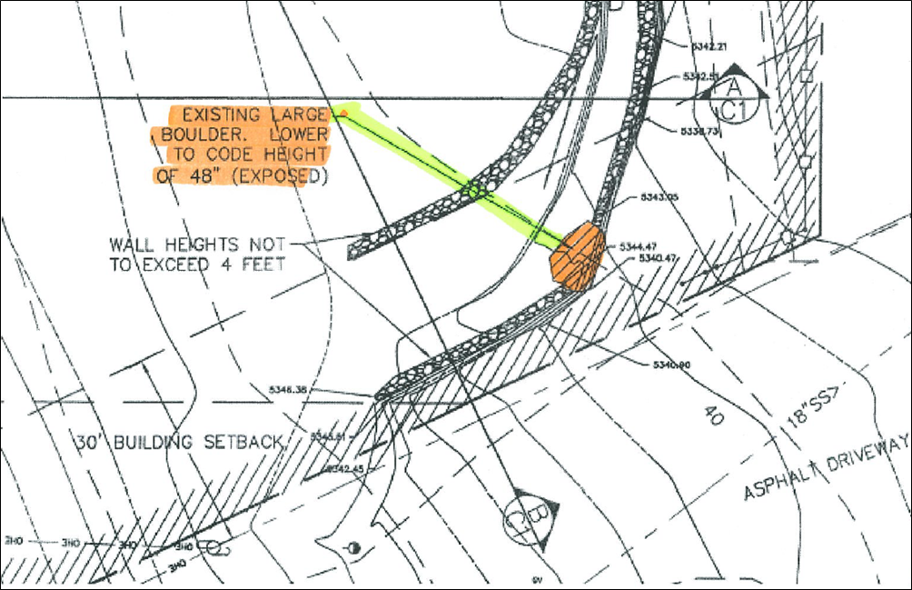
Evaluation

Slide 13
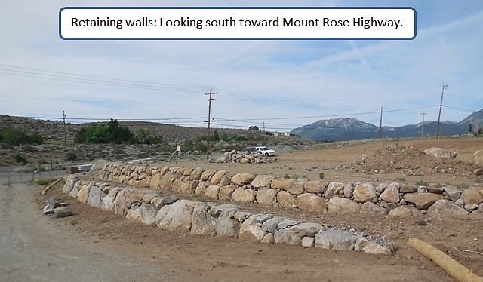
Existing Retaining Walls

Slide 14
Evaluation
Concerns have been expressed regarding the impact of the change to the nature of storm water run-off onto adjacent parcels of land.
The following condition of approval has been included with the recommendation:
“Plans submitted for grading and construction shall include sufficient details to show that any change to the character of the pre-disturbance run-off has been appropriately mitigated.”

Slide 15
STM / WV CAB
The proposed project was presented by the applicant’s representative at the regularly scheduled Citizen Advisory Board meeting on January 11, 2018.
The CAB discussion centered on the ensuring that impacts related to drainage and run-off were appropriately mitigated.
The CAB voted to recommend approval of the proposed Special Use Permit.

Slide 16
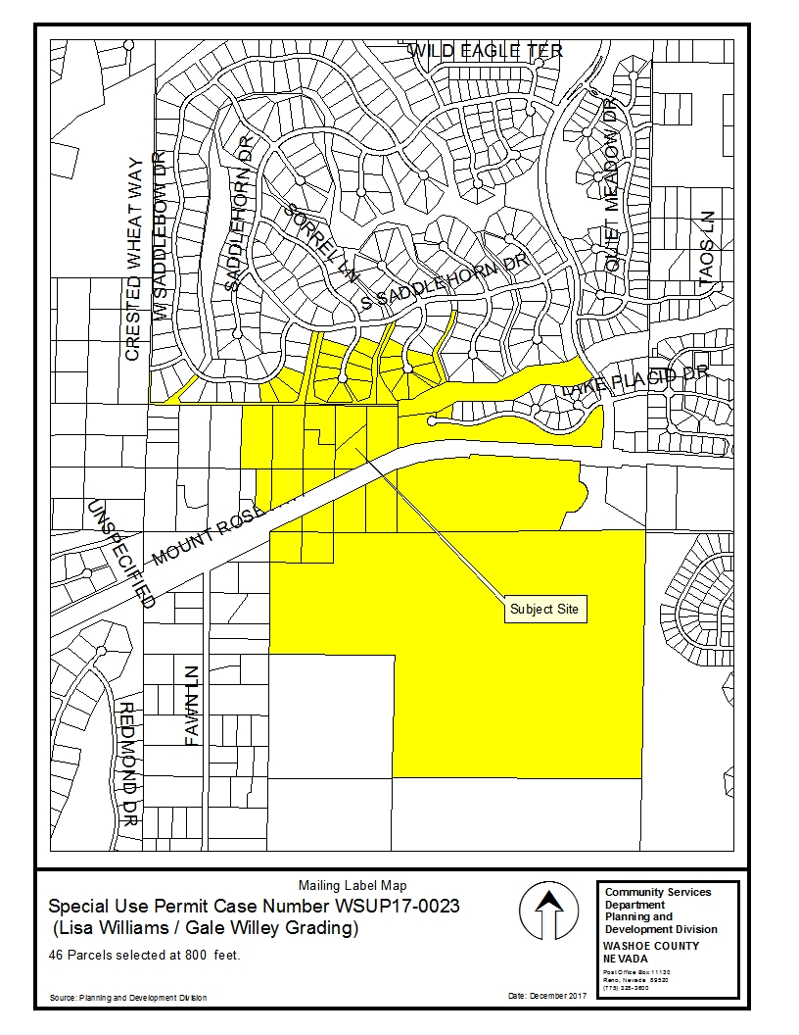
Public Notice
33 individual property owners were noticed for this hearing

Slide 17
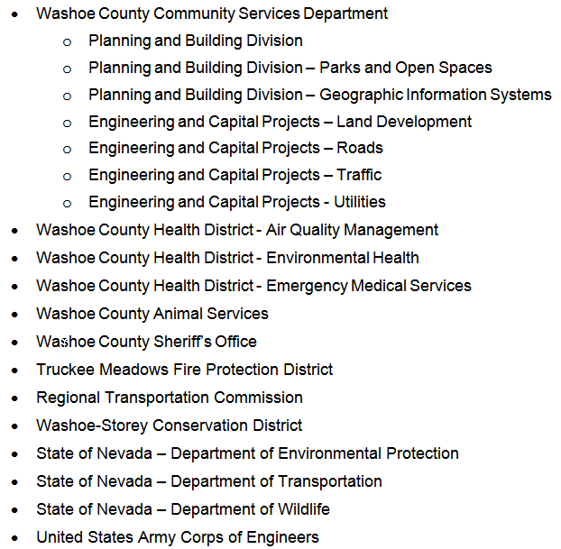
Reviewing Agencies: Three agencies recommended conditions, none recommended denial.

Slide 18
Special Use Permit Findings

Slide 19
Special Use Permit Findings

Slide 20
Special Use Permit Findings

Slide 21
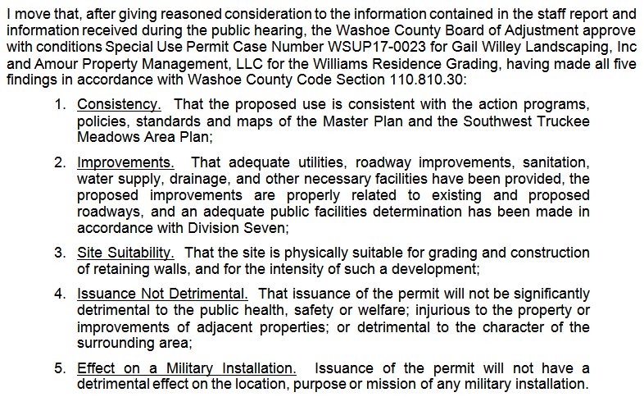
Possible Motion

Slide 22
Questions?

